Slide 2
" In The Name of Allah, The Most Beneficent, The Most Merciful" Concepts on stunning of animals and birds By: Dr. Hani M. Al-Mazeedi

Slide 3
Scope
The purpose of this presentation is to respond the actions of some European parliaments that have voted on the ban of 'traditional religious' slaughter* of animals.
* Slaughter without stunning to comply with religious requirements
© Halal Sciences Academy Limited

Slide 4
This act is considered as a move that will make the Islamic Halal and Jewish Kosher methods of slaughter illegal.

Slide 5
It is also a scientific approach
to show that
divine religious commands
are linked to preserve human health and to
insure animal welfare

Slide 6
Outline
Introduction
A glance on the religious requirements on food.
Religious slaughtering verses non-religious or secular slaughtering methods
Conclusions
Recommendations
© Halal Sciences Academy Limited

Slide 7
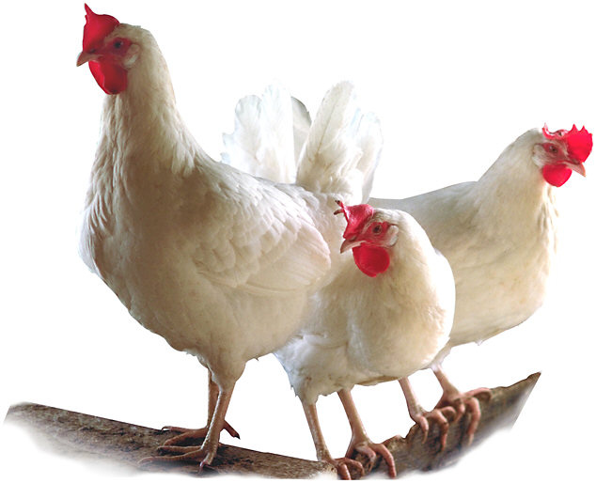
Introduction
There are four main themes that one must address when dealing with slaughtering of animals and birds for food:
1) Religious requirements
2) Human’s safety & health
3) Animal welfare, and
4) To give some considerations that the raw material is alive, has a central nervous system, can express emotion states, and has biological components like humans.
© Halal Sciences Academy Limited

Slide 8
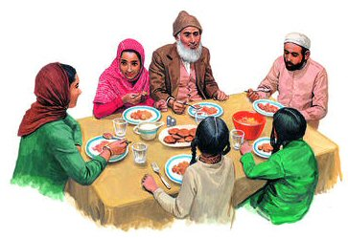
Religious requirements
Religious requirements on food are well expressed by prominent divine religions:
Islam
Christianity
These religions put great emphases on:
Judaism
¹to follow specific way when slaughter of sacrificial animals,
² to follow humane methods in obtaining food from animals and birds
³not to eat pork, or dead meat
⁴not to eat blood, and
⁵to some extent, in some of these divine religions, to avoid drinking alcohol

Slide 9
The law in Europe requires that all animals and birds must undergo pre-slaughtering methods (i.e. stunned) to render them, as they claimed, unconscious or dead before they bleed*.
Lately, there is a call from HAS** for an effective stunning, i.e. complete death of birds before slaughter, i.e. stun-to-kill.
*V. Sante, G. Le Pottier, T. Astruc, M. Mouchonie`re, and X. Fernandez (2000). Effect of Stunning Current Frequency on Carcass Downgrading and Meat Quality of Turkey. Poultry Science 79:1208–1214.
**HAS = Human Slaughter Association (has.org.uk)

Slide 10
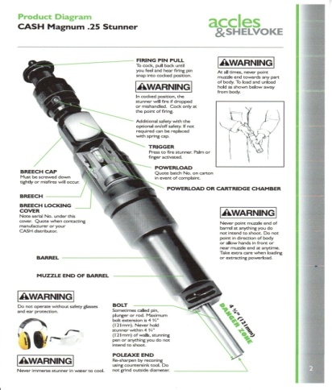
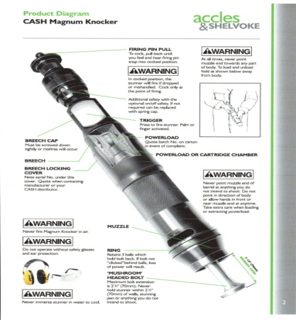
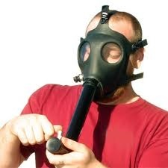
Examples of pre-slaughtering methods (or stunning methods)
Captive-bolt shot into the brain
Mushroom gun shot into the head*
Electric stunning using a water-bath
Electric shock
Controlled atmosphere Killing (CAK) using gas mixtures.
*Percussion stunning ,or air gun stunning

Slide 11
All of these methods substantially causes external & internal injuries to the animal/birds while they are alive (i.e. causes pain to the live animal/birds) and they may (under certain circumstances) lead to their death.

Slide 12
Religious
slaughtering
vs.
Non-religious
or
Secular slaughtering methods

Slide 13
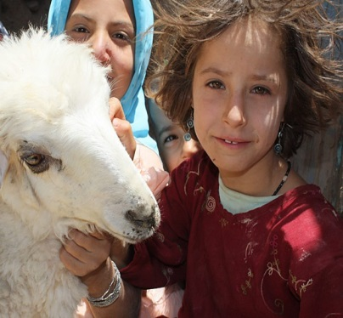
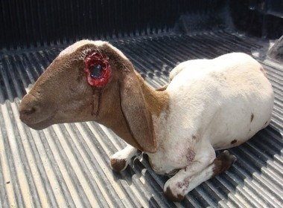
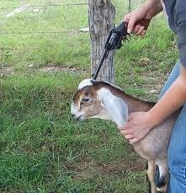
In order for an animal to be religiously slaughtered it must be:
Healthy (free from diseases) with
That is: The animal can live depending on itself at the time of slaughter (i.e. not dying)
Stable life and
Not-deadly injured
These conditions are often not guaranteed with pre-slaughtering methods.

Slide 14
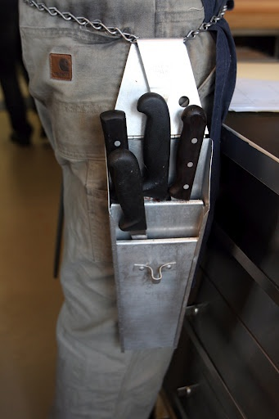
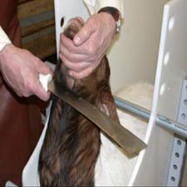
It must be clear that in Halal / Kosher methods the death of an animal or bird should only be caused by the actual one swift cut of a sharp knife and not by or in conjunction with other methods.
Pre-slaughtering methods may participate in the killing of the animal/bird before slaughter.

Slide 15
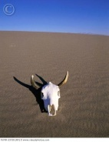
There is a need for Islamic scholars to define the point of death as death is a process and does not occur instantaneously*.
There could be an argument by slaughterhouses that an animal may be slaughtered whilst it is DYING but not yet dead.
We need to say that: the point of death becomes the point at which death is initiated and it should not be intervene with any killing methods (in most cases: stunning will intervene, if used).
Thus as a precautionary basis: Further interventions to slaughter the animal before its death is disallowed because of the risk that the time delay** or a second stunning may result in death before slaughter.
Rizwan Khalid
** this usually happen in the west, a time delay that is cutting of the arteries done after few minutes of stunning)

Slide 16
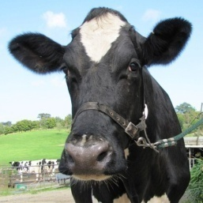
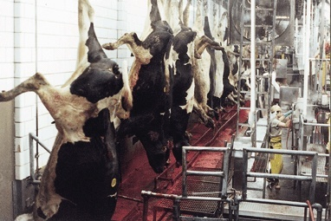
Pre-slaughtering methods for animals in
a Non-Halal Slaughter
With cattle, deer and sometimes sheep, pre-slaughtering methods are done by shooting their heads with a traditional bullet or a steel bolt (shot-to-the-head method).
The bullet or bolt penetrates the skull and injures the brain permanently and ultimately causes death to animals.
*Here the animal is already dead and allowing dropping of his blood out will not make it Halal or Kosher.

Slide 17
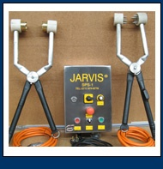
Pre-slaughtering methods for animals in
a Halal Slaughter
Most Halal Slaughter of animals in the west uses electrical stunning.
Cattle, and sheep are gripped by their head with large electrical calipers passing a voltage through it and giving it an electric shock, their throat then cut, to bleed out.
In some countries like New Zealand, and after throat are cut, cow’s esophagus are stabbed with a thorax rod.

Slide 18
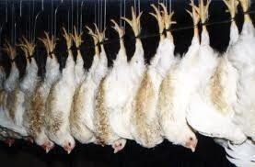
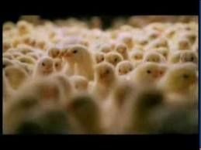
Pre-slaughtering methods for poultry in a Halal Slaughter
Most Halal Slaughter of poultry in the west uses electrical stunning.
Birds are first shackled upside down and then receive an electric shock by immersing their heads in a water-trough through which is passed a voltage, their throat then cut, to bleed out.
Sometimes animal/birds are gassed using
a carbon dioxide/argon mix to make them dead/unconscious, and this is done often during transportation.

Slide 19
The word unconscious has a magical impact to readers.
Does the meat industry really want to render the animal/bird unconscious before slaughter?
Or do they want to speed up the flow of processing lines.
The meat industry takes the animal welfare issue as an excuse for their malpractices to make more profits.

Slide 20
All pre-slaughtering methods are forbidden in strict Halal or Kosher slaughter. Why?
Because some of them render the animal/bird critically irreversibly injured at the time of slaughter with often unstable life (if not dead) that makes them Non-Halal / Non-Kosher and forbidden as a source of food to Muslims and Jews.

Slide 21
So, what is stunning?
And what's wrong with it?
Many used it and ascertained that it is in favor of animal welfare and if used will not cause or lead to death!!
OK, let us examine our religious commands against their secular claims.

Slide 22
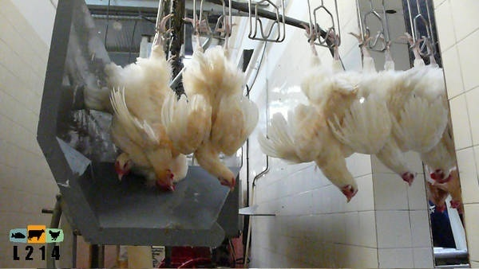
Practically, stunning is a pre-slaughtering method that make the animal or bird at the time of slaughter motionless.
In certain types of stunning such as electrical stunning of chickens, stunning will make them at the time of slaughter temporarily without breathing as well.

Slide 23
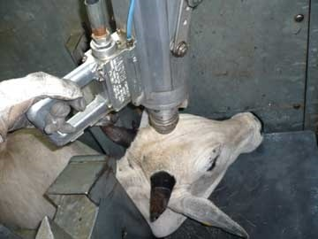
What is the effect of stunning on animal/bird before slaughter?
If percussive captive bolt stunner is used and the stunned animals left without slaughtering they will not go back to life (i.e., Mawqoozah موقوذة).

Slide 24
With electrical stunning, many variables decide its quality in term of animal’s death and living, and the most important ones are:
The combination of
Current (mA) and Frequency (Hz)
However
Low frequency is by far the biggest factor in causing death but we cannot rule out the effect of high current*.
* Rizwan Khalid

Slide 25
Accordingly, chicken carcasses, which comes to all GCC and Middle East countries from Europe, America and Brazil, that are accompanied with a Halal certificate and are stunned*, ** with a frequency of 50 Hz the percentage rate of killed ranged from 61%-99%.
At 60 mA the rate kill is 22%
with 50 Hz frequency
At 75 mA the rate kill is 61%
*Gregory N.G. & Wotton S.B. (1990). Effect of stunning on spontaneous physical activity and evoked activity in the brain. British Poultry Science. 31: 215-220.
**Gregory, N. G., and S. B. Wotton (1987). Effect of electrical stunning on the electroencephalogram in chickens. Br. Vet. J.: 143, 175-183.
***S. Prinz, G. Van Oijen, F. Ehinger, A. Coenen and W. Bessei (2010). Electroencephalograms and physical reflexes of broilers after electrical waterbath stunning using an alternating current. Poult Sci. 89:1265-1274.
At 90 mA the rate kill is 80%
At 120 mA the rate kill is 95%
At 148 mA the rate kill is 99%
***At 70-100 Hz, at 100 mA the rate kill is 80%
***At 200 Hz, at 120-150 mA the rate kill is 80%

Slide 26
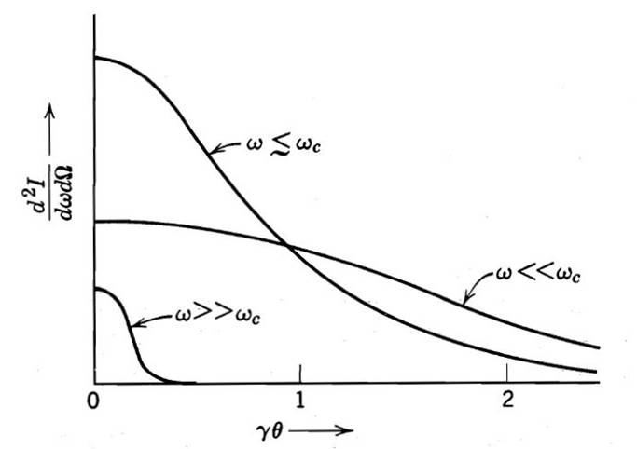
The criteria for stunning with electrical shock is very critical and must be accurate in terms of its numerical values.

Slide 27
It is also difficult to ensure a 100% Halal control of birds with electrical stunning because:
Any changes in the trend or the frequency or distance or weight or resistance, or the amount of feathers on the body as seen from published works will result in a mortality rates could reach a value ​​that can not be tolerated from the standpoint of their religious legitimacy.
*Kettlewell, P.J. and Hallworth R.N. (1990). Review paper, Electrical stunning of chickens. J. agric. Engng Res. 47, 139-151.

Slide 28
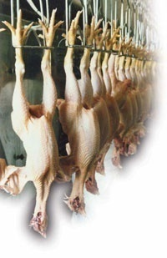
In France as well as in many European countries (and if not observed well by Muslims) birds are stunned-to-kill at low frequencies (50Hz)*.
Also, the electrical stunning requirements of the new European Slaughter Legislation 1099/2009 is stun-to-kill! So we may not even be allowed to use different currents/frequencies**.
*V. Sante, G. Le Pottier, T. Astruc, M. Mouchonie`re, and X. Fernandez) 2000(. Effect of Stunning Current Frequency on Carcass Downgrading and Meat Quality of Turkey. Poultry Science 79:1208–1214.
* *Rizwan Khalid

Slide 29
At low frequencies (50Hz) a ventricular fibrillation الرجفان البطيني appears, which is one of the signs of a heart attack السكتة القلبية(i.e. death).
This phenomenon scientifically well established and is clearly seen with electrical stunning of animal or birds at very low-frequency (such as 50Hz).

Slide 30
The ventricular fibrillation (i.e. death) is confirmed by Dr. Neville George Gregory of the University of Bristol* a pioneer scientist on the impact of electric shocks on birds and animals before slaughter: the proportion of deaths among chickens with electric current of 148 mA at frequency of 50 Hz prior to slaughter is 99%.
At 50 Hz with electric current of 148 mA the rate kill is 99 %
*Gregory, N. G., and S. B. Wotton (1987). Effect of electrical stunning on the electroencephalogram in chickens. Br. Vet. J.: 143, 175-183.

Slide 31
Moshonner M.* and his colleagues published the results of their research, conducted on Turkey weigh on an average between 5-7 kg to identify the impact of electrical stunning at high frequency, with fix electrical current of 150 mA for 4 seconds and different frequencies. The results of their published research were as follows:
At 50 Hz the rate kill is 100%
with 150 mA
At 300 Hz the rate kill is 60%
At 480 Hz the rate kill is 30%
At 550 Hz the rate kill is 30%
At 600 Hz the rate kill is 0 %
*M. Mouchoniere` RE, G. Le Pottier, and X. Fernandez (1999). The Effect of Current Frequency During Waterbath Stunning on the Physical Recovery and Rate and Extent of Bleed Out in Turkeys. Poultry Science 77:485–489.

Slide 32
But the European regulations** allow the use of electrical stunning on Turkey less than 600 Hz at 400 mA.
Table — Electrical requirements for water bath stunning equipment (average values per animal) **
Frequency (Hz) | Chickens | Turkeys | Ducks and geese | Quails
< 200 Hz | 100 mA | 250 mA | 130 mA | 45 mA
From 200 to 400 Hz | 150 mA | 400 mA | Not permitted | Not permitted
From 400 to 1 500 Hz | 200 mA | 400 mA | Not permitted | Not permitted
**Regulations: Council regulations (EC) No 1099/2009 of 24 September 2009 on the protection of animals at the time of killing. Official Journal of the European Union. http://eur-lex.europa.eu/JOHtml.do?uri=OJ:L:2011:040:SOM:EN:HTML

Slide 33
i.e. the rate of mortality in Turkeys would be expected to be greater than 50% using 400 Hz with 400 mA rather than the 150 mA current used by Moshonner M. and his colleagues, so with:
With 150 mA, at 300 Hz the rate kill is 60%
With 400 mA, at 400 Hz the rate kill is expected to be greater than 50%
With 150 mA, at 480 Hz the rate kill is 30%

Slide 34
At higher stunning frequencies (1500Hz) chickens will recover back to clear signs of life that is breathing and moving after 16 seconds and 57 seconds respectively after stunning*.
*Gregory, N. G., L. J. Wilkins, and S. B. Wotton, (1991). Effect of electrical stunning frequency on ventricular fibrillation, downgrading and broken bones in broilers, hens and quails. Br. Vet. J. 147:71–77.

Slide 35
But with stunning at high frequency, the slaughtering process is much faster (11-14 seconds) than the time chickens recover back to clear signs of life (16-57 seconds).
So, what is the religious verdict?

Slide 36
We find the religious verdict in the Muwatta الموطأ, of Imam Malik for the religious slaughter, he said: if the animal/bird at the time of slaughter has No ongoing breathing and it is not in a disturbance state, then its meat after slaughtering is not allowed to be eaten *.
*الموسوعة الفقهية، الجزء التاسع والثلاثون، ص 324، وزارة الأوقاف والشئون الإسلامية، دولة الكويت.

Slide 37
He رحمه اللهalso said: With Mawqoozah and in similar cases, if the animal/bird can not live with, it is not permissible to eat its meat even if it was slaughtered before death*.
In Islam, the general rule of meat is unlawful until proven to be without any doubts it is Halal.
Stunning definitely put meats in doubts, and thus EATING STUNNED MEAT will become unlawful if doubts are associated with its slaughter until proven to be without any doubts.

Slide 38
Sheikh Prof. Nasser bin Abdullah Al Maiman has said*
On the basis of what have been said on the use of stunning
It is better not to resort to any method of loss of consciousness; we should close the door of its discussion once and for all; as if we opened it both lawful and unlawful things will be entered.
* Professor of Higher Islamic Studies, Umm Al-Qura University, Makkah, and a member of the Shura Council, Saudi Arabia

Slide 39
Stunning methods definitely jeopardize the religious requirements of slaughter.

Slide 40
The Law in some European countries recognizes that “conventional” stunning methods الصعقare not permitted for Halal / Kosher food.
These countries legislates for Halal / Kosher to be exempted from such stunning for meat of local use only and not for export provided the animal is prepared “Halal / Kosher” by a duly licensed Halal / Kosher.

Slide 41
Theoretically, stunning should cause less amount of bleeding.
However, few published works showed just the opposite.

Slide 42
Pattern of bleeding:
The hadith of prophet Mohammed peace be upon him focuses on the pattern of bleeding rather than the amount of blood that comes out at the time of actual cut of the arteries.
We believe that the pattern of bleeding at the time of slaughter could be used as a an indirect sign of the religious legitimacy of the slaughter (Healthy slaughter).
The pattern of bleeding may have an impact on the purification and drainage of impure blood from internal tissues such as muscles (arteries, breast, thigh, and wings).

Slide 43
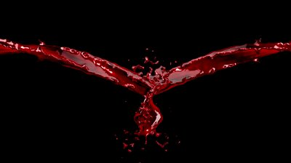
عن رافع بن خديج رضي الله عنه: عن النبي صلى الله عليه وسلم قال: « ما أنهر الدم وذكر اسم الله عليه فكل، ليس السن والظفر، أما السن فعظم، وأما الظفر فمدى الحبش »* متفق عليه.
Prophet Mohammed peace be upon him said (translation): «What causes it to bleed like a gushing river and the name of God was uttered upon it then eat, ------------------------»* Agreed.
Bleeding like a gushing river is a pattern of bleeding that usually occurs when we do not use stunning prior to slaughter due to heart sleeping.
Bleeding like a gushing river pattern will not exist with a delayed slaughter after stunning.
*البخاري : الشركة (2488) , ومسلم : الأضاحي (1968), والترمذي: الأحكام والفوائد (1491), والنسائي: الضحايا (4410), وأبو داود: الضحايا (2821), وأحمد (3/463).

Slide 44
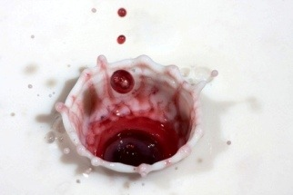
The pattern of bleeding with a delayed slaughter after stunning is like dropping bloods (liquid being poured from its reservoir) and not like a gushing river.

Slide 45
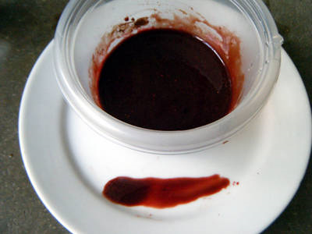
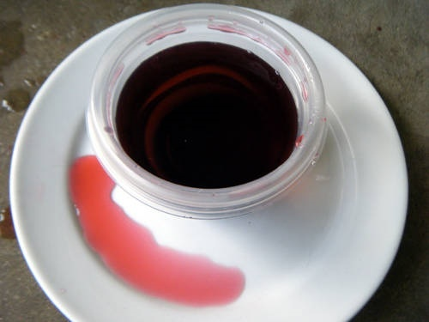
The color of blood, as reported by some observers, of the stunned animal with delayed slaughter* is dark red in color and not light red as in the case of non stunned animal.
*delayed slaughter = cut of the neck is done after few minutes of stunning.

Slide 46
What follows is that the use of pre-stunning methods does not comply with Halal standards because it does not meet the criteria of bleeding pattern as prescribed in the previous hadith

Slide 47
Human’s safety & health
Blood is a good environment for the growth of bacteria and microbes.
In general, meat carcasses nearly sterile before slaughtering process.
However, if the animal is exposed to stress (compression, tension, or fatigue such as stunning) prior to slaughter, meat of such animals can be severely contaminated after slaughtering.
http://pathogencombat.wur.nl/ContextualFactors/ProductProcessCharacteristics/RiskRawMaterials/Shared%20Documents/raw_materials.pdf

Slide 48
In this case the total number of bacteria may be increased to thousands per gram of meat.
Certain fatigue such as electrical stunning may cause small capillaries in the muscles to be ruptured, these capillaries are the bloodstream.

Slide 49
The free blood that is forbidden in religious law and not trapped blood inside the meat after religious slaughter.
It is here that one realizes the wisdom and the legitimate purpose of Religious Slaughtering that Allah (God) swt سبحانه وتعالىcommanded before eating the meat of sacrificial animals, so that harmful malignant in blood is properly expelled out.

Slide 50
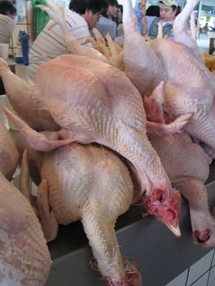
There are other health risks with stunned meat that is the eating of dead meat, i.e. slaughtering will be of no value with dead animal.
So, what is the adverse health effect of eating dead meat?
When sacrificial animal die, bacteria will transmit across the gut very quickly, so there is a need to slaughter the animal when they are fully alive and eviscerate نزع الأحشاء quickly to prevent pollution.
http://www.backyardchickens.com/t/697920/dead-meat-bird-okay-to-eat

Slide 51
The adverse health effect from eating Pork and its by products are well documented in literatures.
Professor Hans in his biological therapy has based his observations on the Germans before and after the consumption of pork products, and this is what he found:
Eating pork may causes tension, stress, fatigue and toxicity
Hans-Heinrich Reckeweg, 1983. The Adverse Influence of Pork Consumption on Health. Biological Therapy Vol.1 No. 2 1983 http://www.firstchurchoftheinternet.org/studies/eatingpork.htm

Slide 52
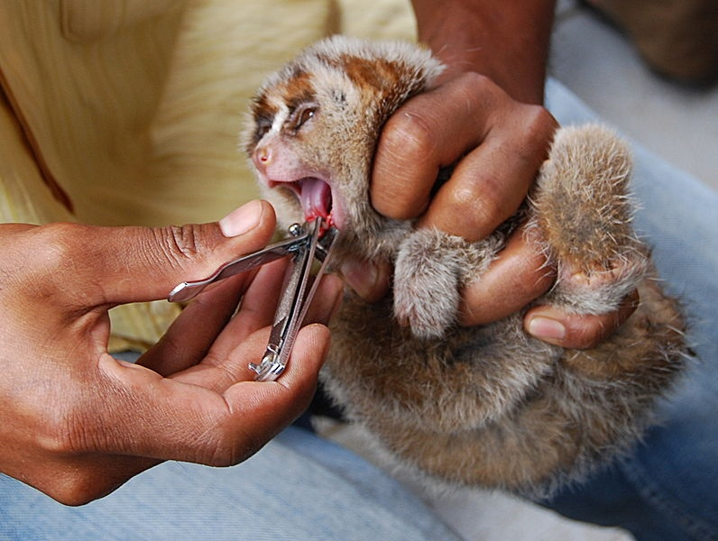
Animal welfare
So far we have discussed the hygienic aspects involved with ritual slaughter.
Let us now determine to what extent pre-slaughter methods can be painful (or cruel).

Slide 53
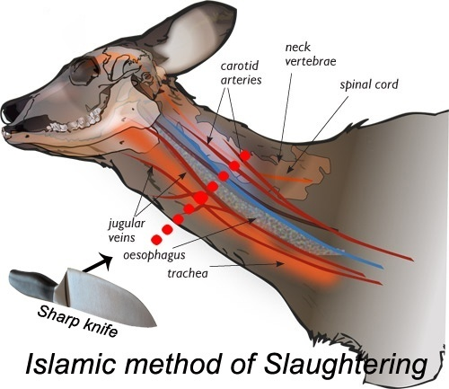
When the Halal / Kosher incision is made on the animal’s neck, it severs the major organs that is the:
Arteries and veins
Thereby causing a massive and immediate drop in blood-pressure in the brain.
The incision takes a second to perform, and the animal is rendered unconscious فاقد الوعي within seconds.

Slide 54
How much painful is the pre-slaughter methods?
Only Allah سبحانه وتعالىswt (God) the Creator of the animal and the animal which undergoes stunning while being disposed knows.

Slide 55
But we (humans) can ascertain pain from ritual slaughter by considering how much painful similar process would be if inflicted on us, in the light of anatomical and physiological bases of perception of pain.

Slide 56
It is generally known that we do not perceive when we accidently cut ourselves during shaving with a sharp new blade until after it has happened and when the bleeding draws our attention to it.

Slide 57
We also know too well the difference between the smooth shave with a new blade and one with a blunt blade.
Hence it is essential that the knife used in slaughtering of animals should be sharp.

Slide 58
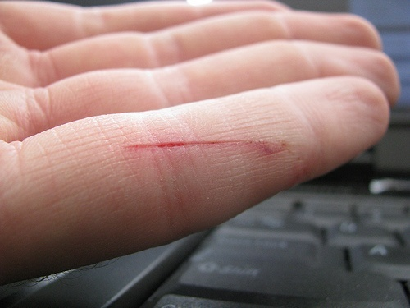
The cut by the blade during shaving bleeds very little as only tiny capillaries are cut and we feel the pain only after the perception of our brain.

Slide 59
With animals, the cut severs four major blood vessels in the neck, through them so much blood is lost so quickly that the animal faints يغمى عليه and the sensation of pain in the sensory center of the animal's brain is abolished.

Slide 60
Conclusions
Stunning methods definitely jeopardize the religious requirements of slaughter.
We can see by now that: Method of slaughtering is of great importance to animal welfare, meat safety & hygiene and has significant impact on human health.
Seculars claim that: Human health & Animal Welfare are not linked with religious prohibitions.
Many religious prohibitions were found to be linked to human health and animal welfare.

Slide 61
Recommendations
Establishment of well Dedicated Halal Law in importing countries.
Circulate Halal Standards and Requirements of importing countries.
Unifications of Fatwas on Halal issues based on firm religious evidences.
Spread Halal Education among consumers in importing countries.
Label clearly on the packed meat if it was stunned or not

Slide 62
Finally
On the basis of what have been said on the use of stunning
It is better not to resort to any method of loss of consciousness; we should close the door of its discussion once and for all; as if we opened it both lawful and unlawful things will be entered.
* Sheikh. Nasser bin Abdullah Al Maiman, Prof. of Higher Islamic Studies, Umm Al-Qura University, Makkah, and a member of the Shura Council, Saudi Arabia

Slide 63
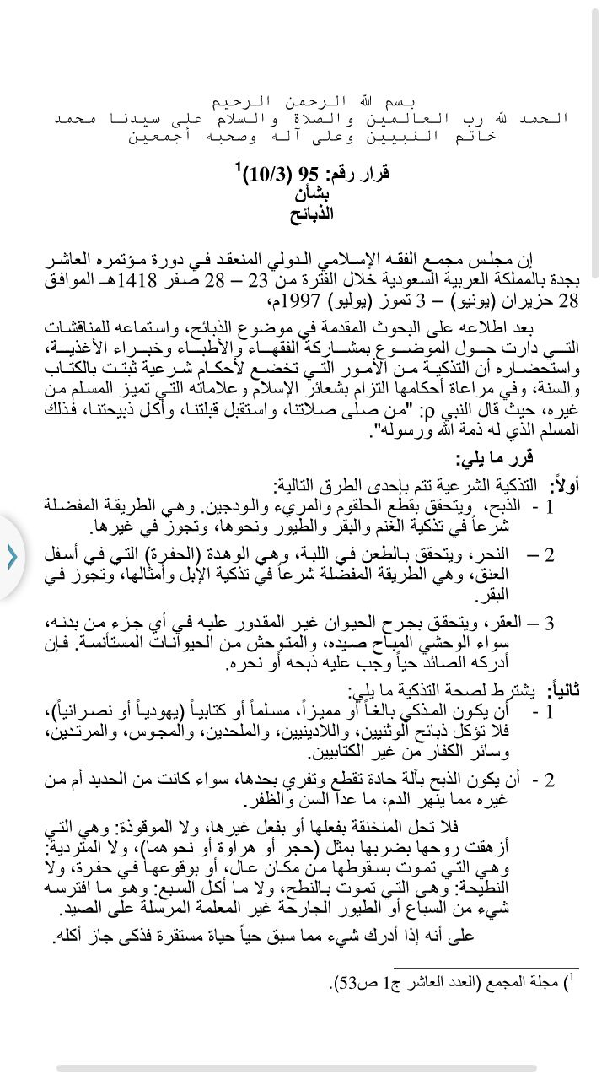

Slide 64
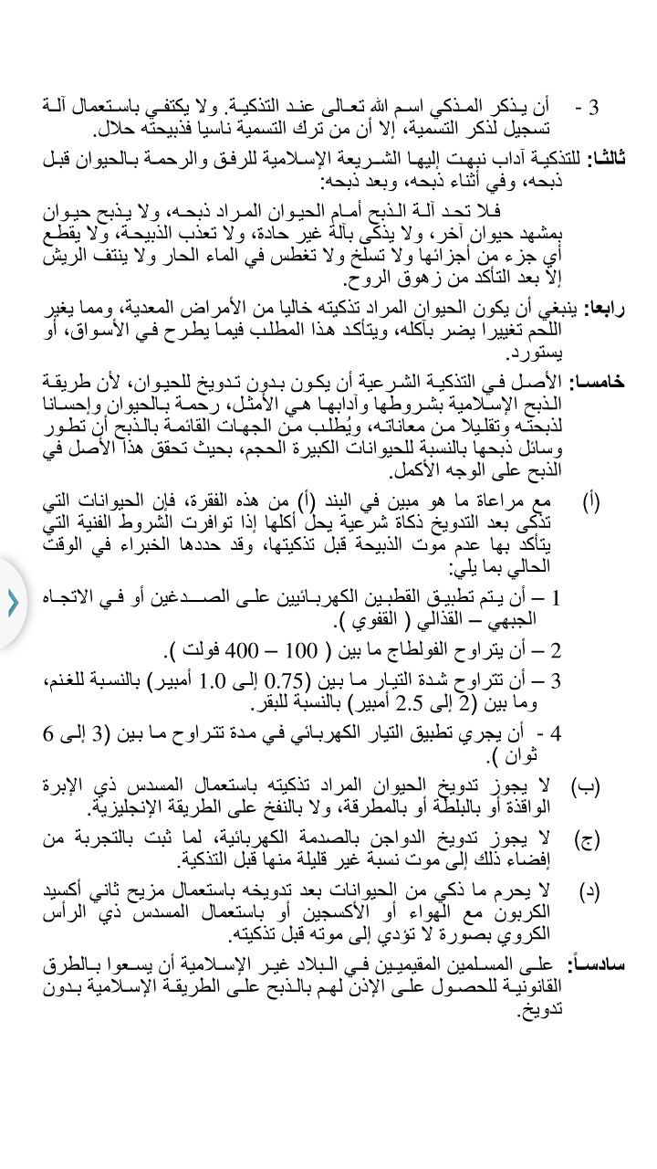

Slide 65
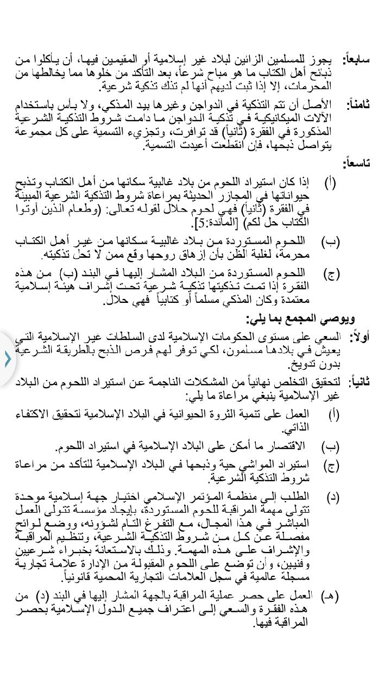

Slide 66
References:
¹V. Sante, G. Le Pottier, T. Astruc, M. Mouchonie`re, and X. Fernandez) 2000(. Effect of Stunning Current Frequency on Carcass Downgrading and Meat Quality of Turkey. Poultry Science 79:1208–1214.
²Rizwan Khalid of Bristol University.
³Gregory N.G. & Wotton S.B. (1990). Effect of stunning on spontaneous physical activity and evoked activity in the brain. British Poultry Science. 31: 215-220.
⁴Gregory, N. G., and S. B. Wotton (1987). Effect of electrical stunning on the electroencephalogram in chickens. Br. Vet. J.: 143, 175-183.
⁵S. Prinz, G. Van Oijen, F. Ehinger, A. Coenen and W. Bessei (2010). Electroencephalograms and physical reflexes of broilers after electrical waterbath stunning using an alternating current. Poult Sci. 89:1265-1274.
⁶Kettlewell, P.J. and Hallworth R.N. (1990). Review paper, Electrical stunning of chickens. J. agric. Engng Res. 47, 139-151.
⁷M. Mouchoniere` RE, G. Le Pottier, and X. Fernandez (1999). The Effect of Current Frequency During Waterbath Stunning on the Physical Recovery and Rate and Extent of Bleed Out in Turkeys. Poultry Science 77:485–489.
⁸ Regulations: Council regulations (EC) No 1099/2009 of 24 September 2009 on the protection of animals at the time of killing. Official Journal of the European Union. http://eur-lex.europa.eu/JOHtml.do?uri=OJ:L:2011:040:SOM:EN:HTML
⁹Gregory, N. G., L. J. Wilkins, and S. B. Wotton, (1991). Effect of electrical stunning frequency on ventricular fibrillation, downgrading and broken bones in broilers, hens and quails. Br. Vet. J. 147:71–77.
الموسوعة الفقهية، الجزء التاسع والثلاثون، ص 324، وزارة الأوقاف والشئون الإسلامية، دولة الكويت. ¹⁰
¹¹ Sayda A. M. Ali, Hyder O. Abdalla, and Ibrahim M. Mahgoub: Effect of slaughtering methods on the keeping quality of broilers chickens meat (email: saydamhmmd@yahoo.com)
¹²البخاري : الشركة (2488) , ومسلم : الأضاحي (1968), والترمذي: الأحكام والفوائد (1491), والنسائي: الضحايا (4410), وأبو داود: الضحايا (2821), وأحمد (3/463).
¹³Zabh Halal VS. Stunning Method, By: Dr Jawad Hidmi (PhD)

Slide 67
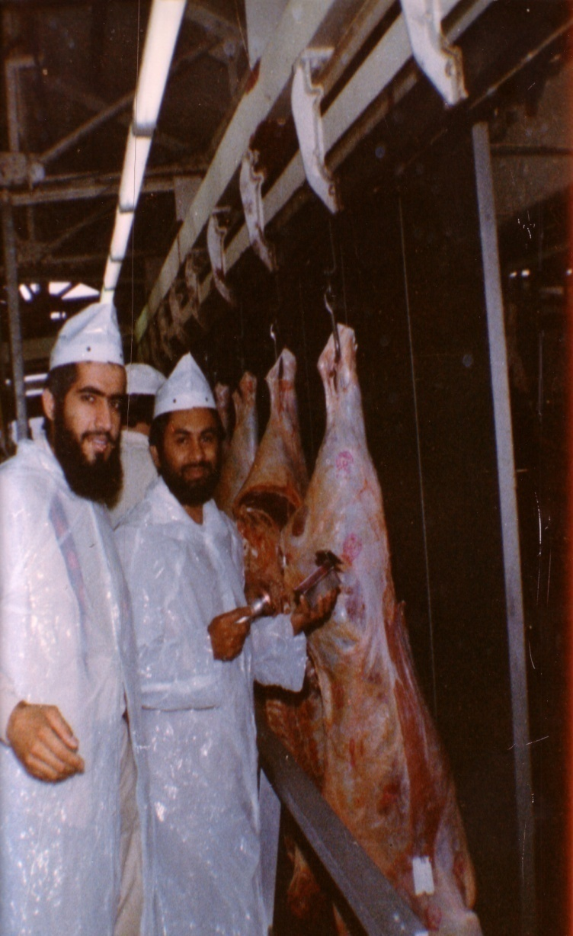
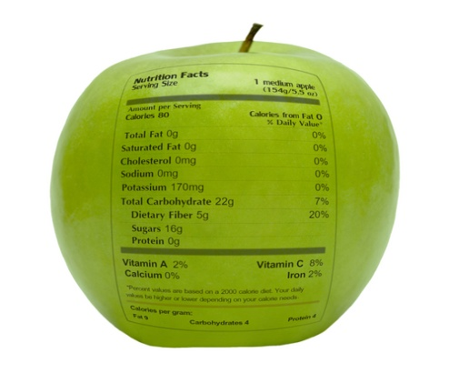
شكراً لاستماعكم
سبحنك اللهم وبحمدك أشهد أن لا إله إلا أنت، أستغفرك وأتوب إليك
د. هاني منصور المزيدي
مع الأخ أمجد محبوب في أستراليا سنة 1981
Dr. Hani Mansour Al-Mazeedi
With brother Amjad Mahboob in Australia in 1981

Slide 68
www.HalalEA.com
Trademarks, icons, images belong to their respective owners.
© Halal Sciences Academy Limited

